Slide 1
3 Axis Pin Development Update
Week #6?

Slide 2
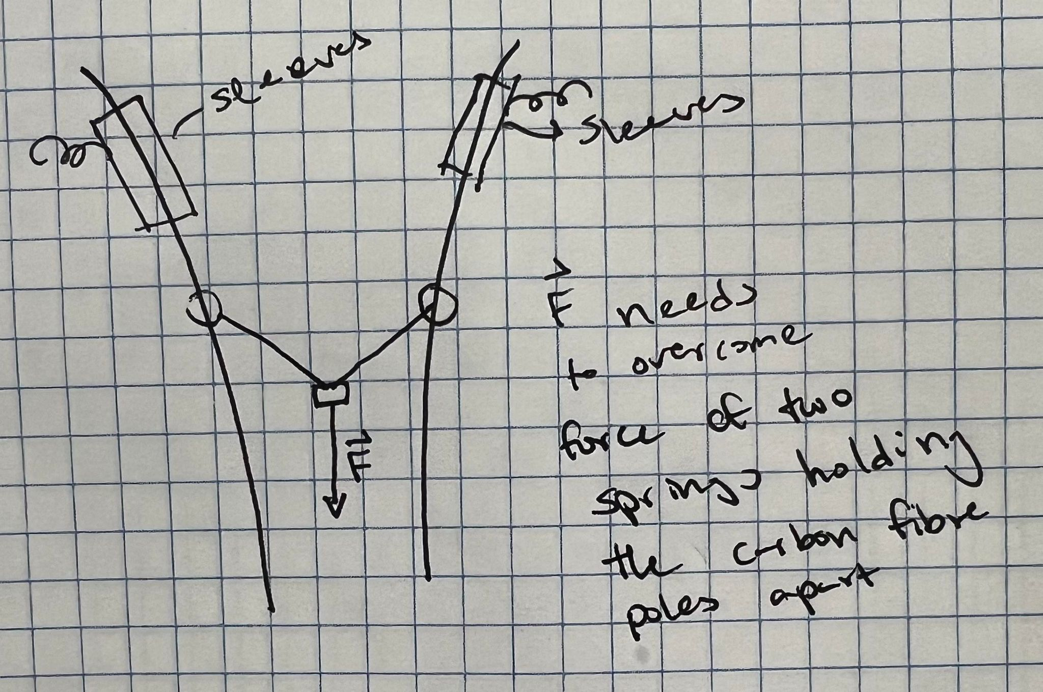
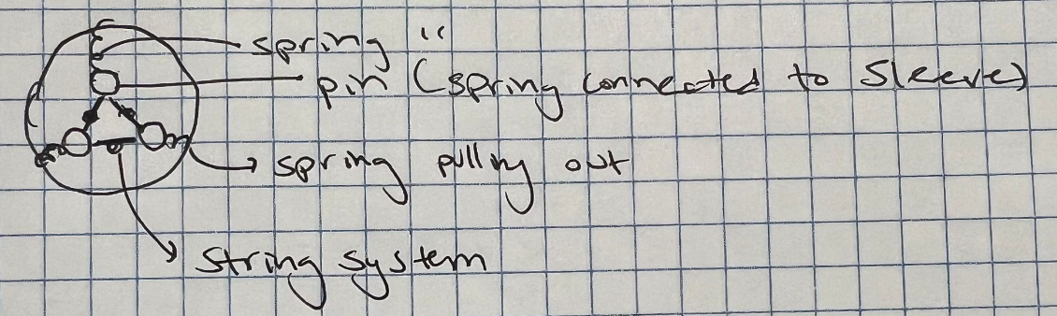
Idea

Slide 3
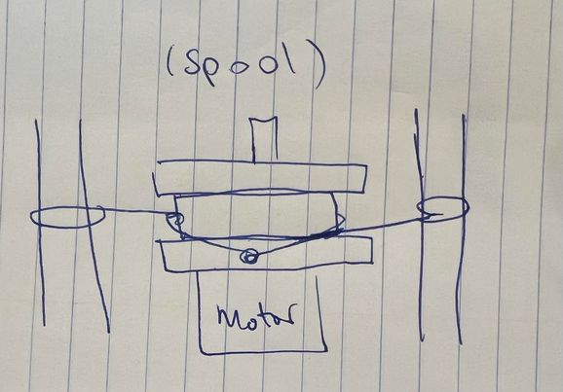
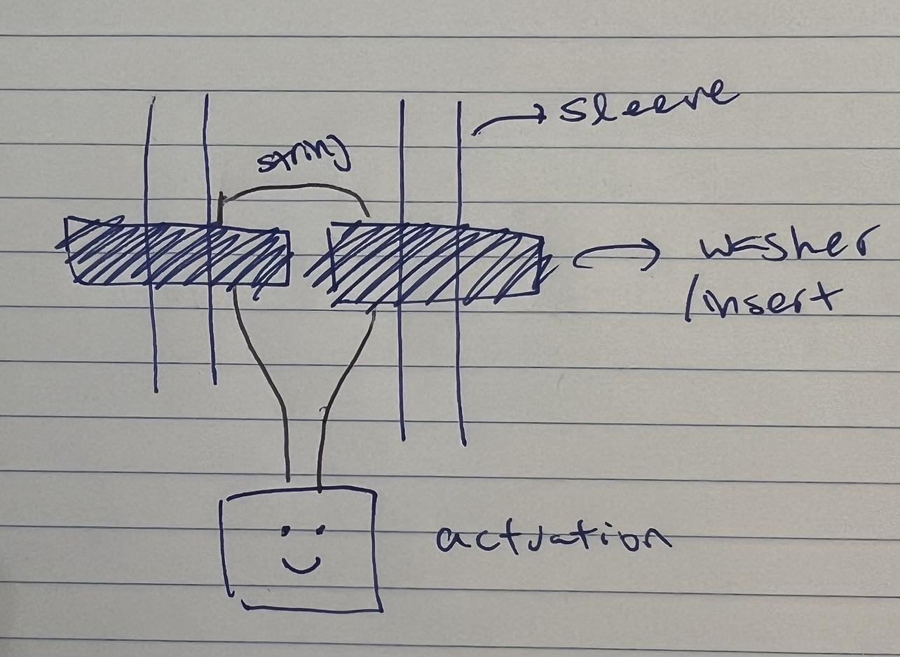
More Ideas…

Slide 4
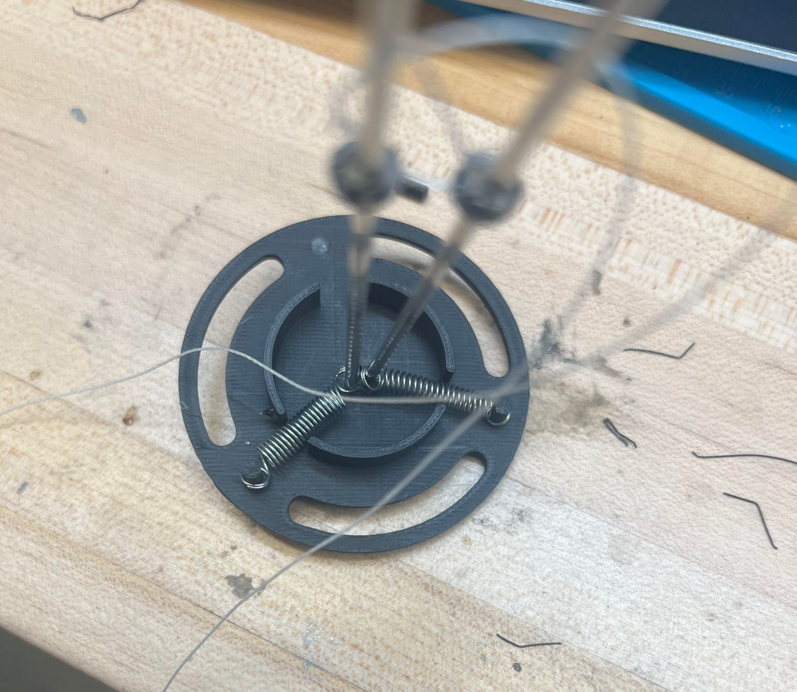
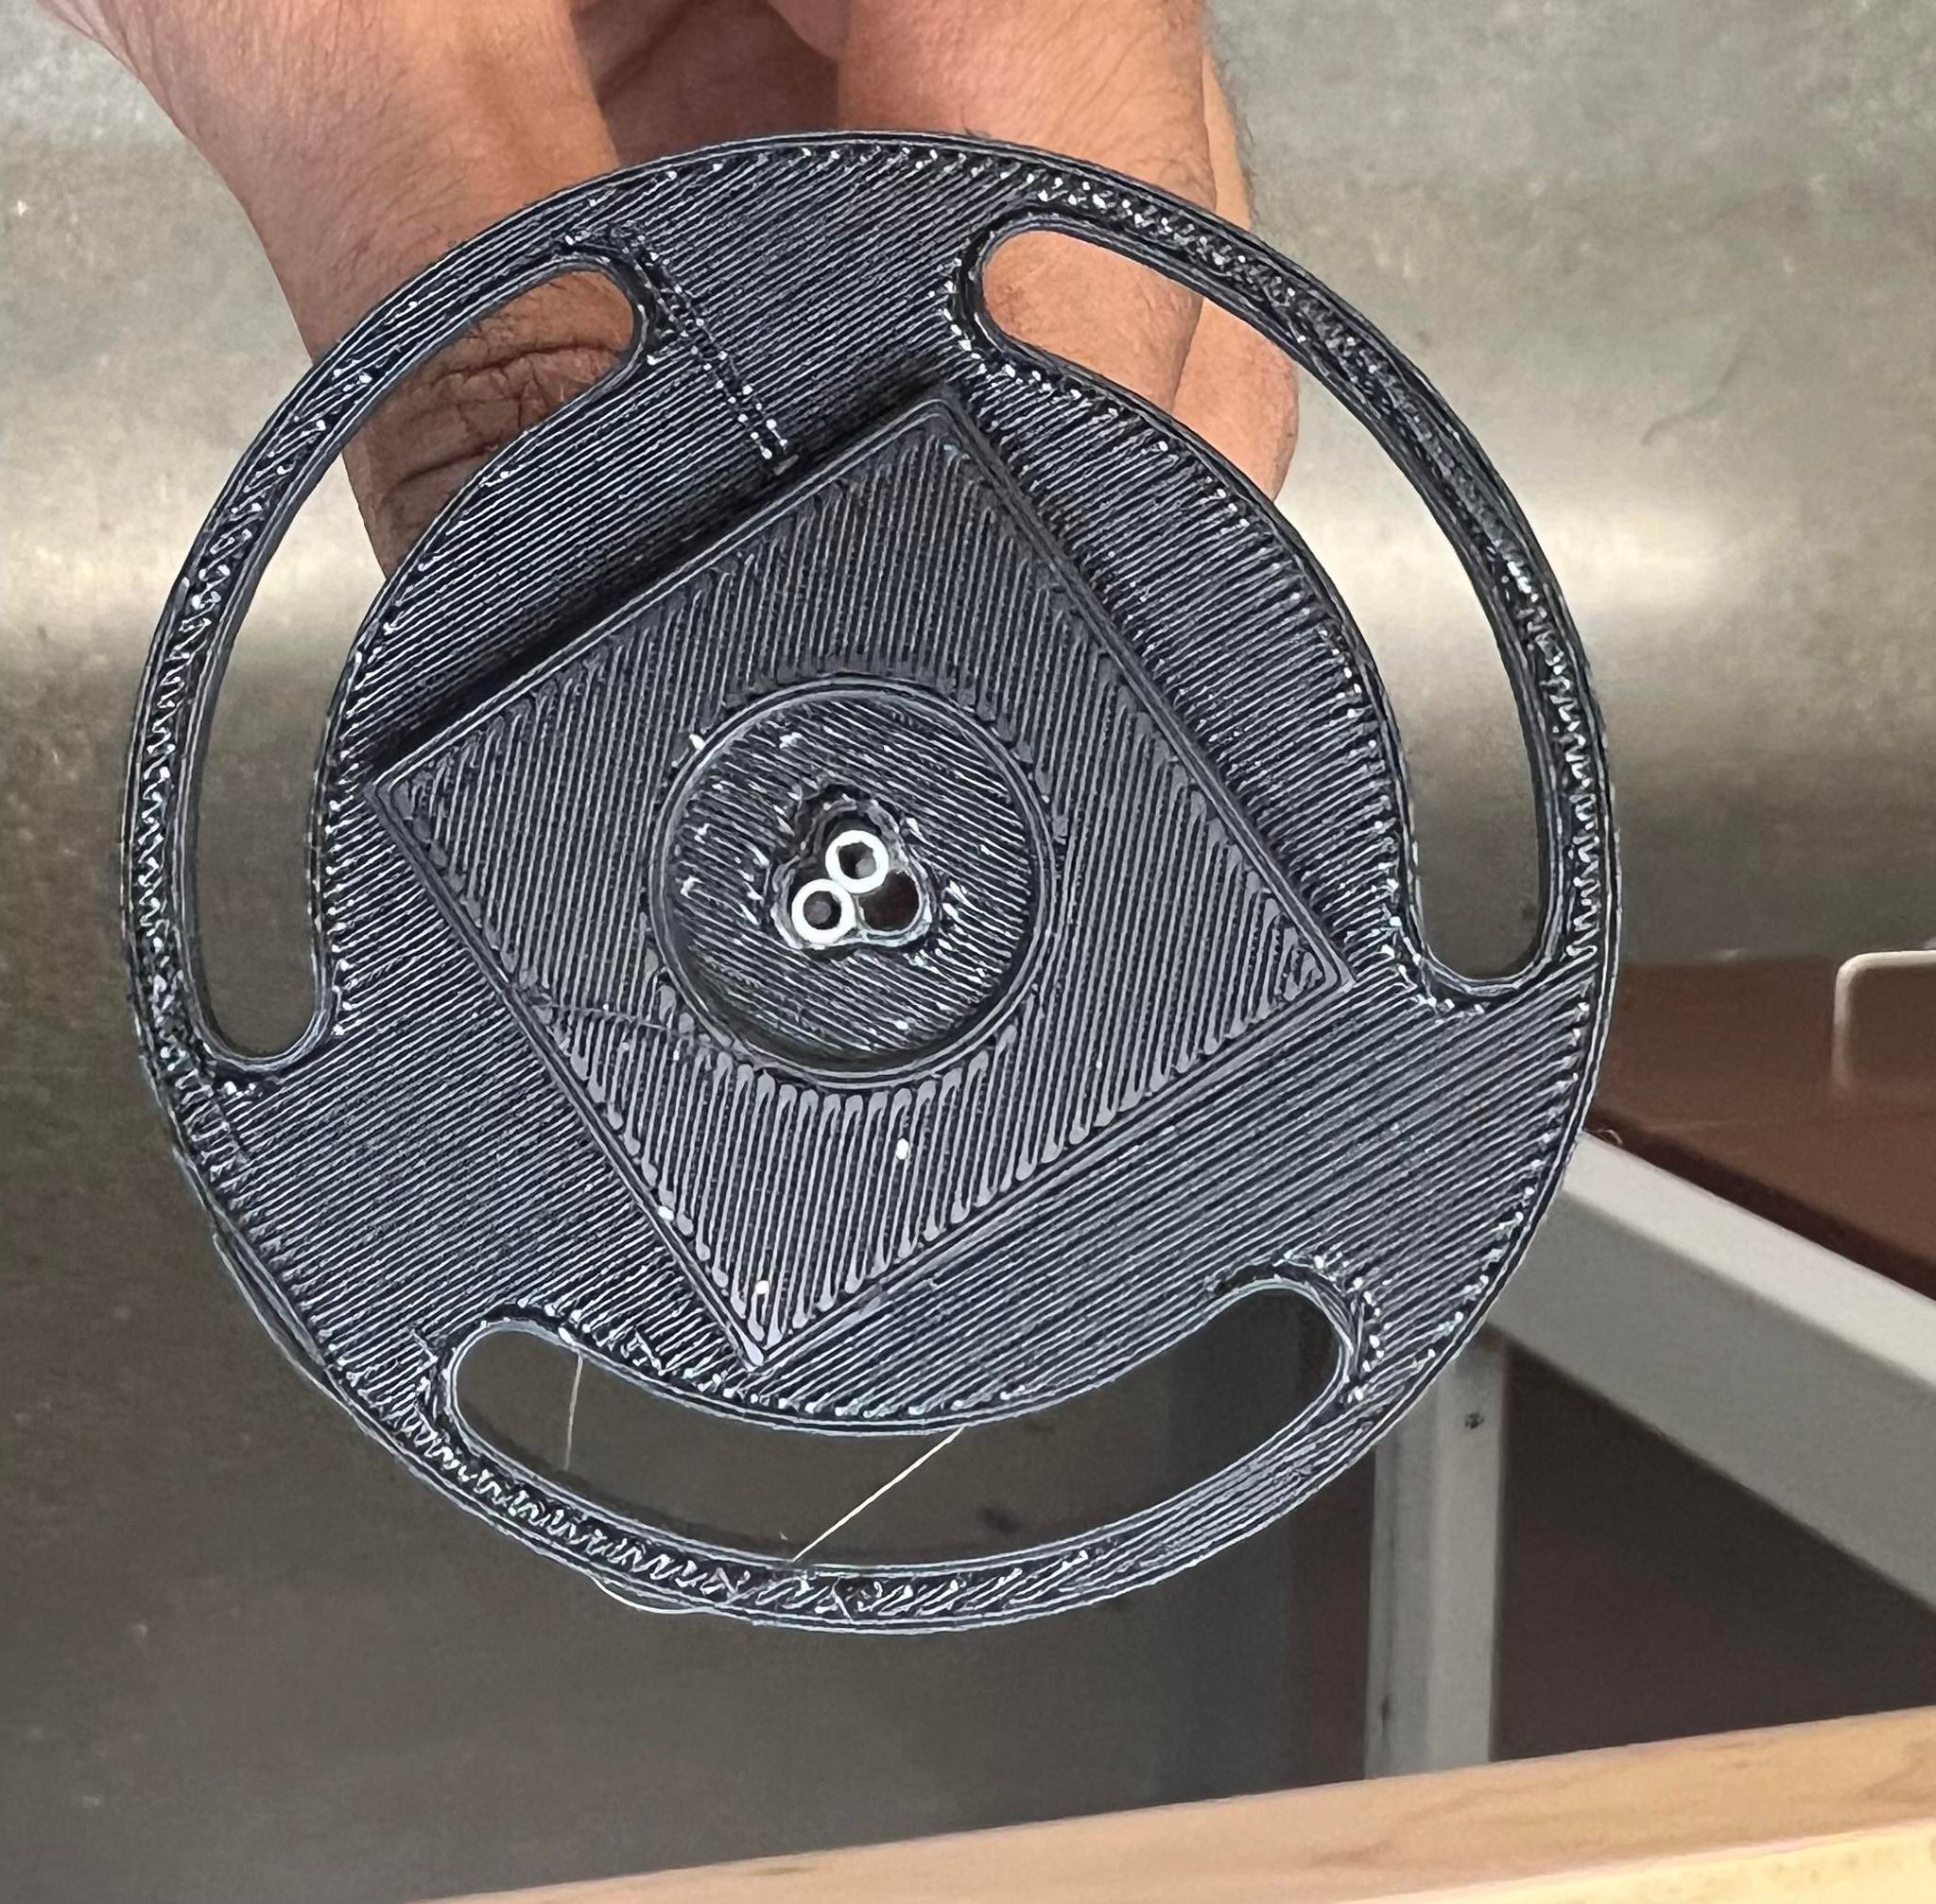
Prototype #3

Slide 5
Current Problems
Washer Method
String needs to be able to freely move
Smaller Springs
Spacing between sleeves
Need to be bigger

Slide 6
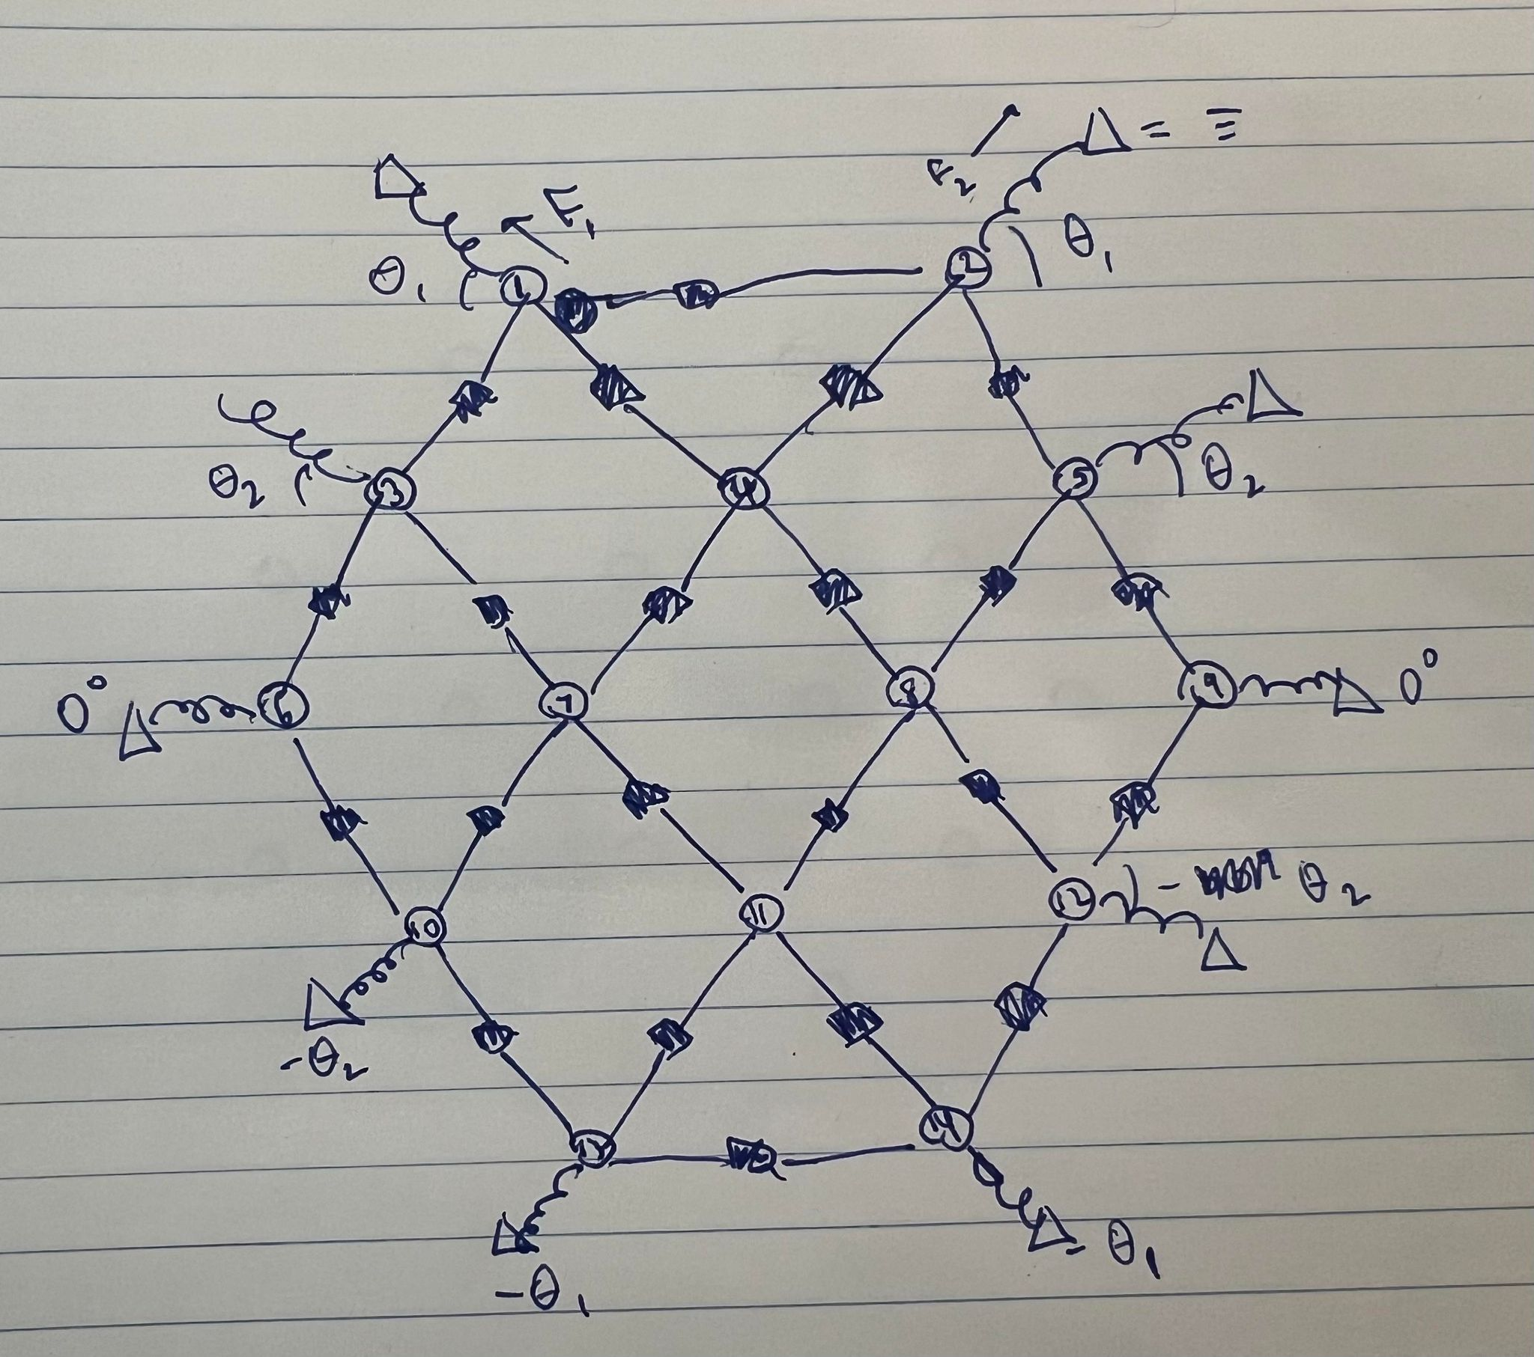
Current Arrangement

Slide 7
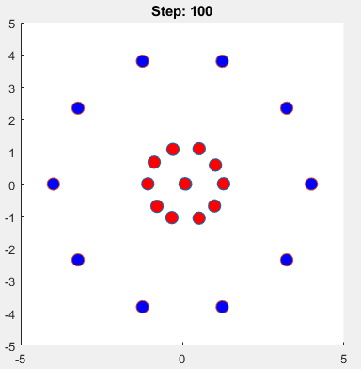
Model? Weird thing I did over break…
22 force vector inputs
Introduced fixed points as grounds
Random starting position
Developed starting (at rest) configuration
Further work
Given input vector of forces between pins
Find displacement
Or reverse? Find ‘closest’ approximation

Slide 8
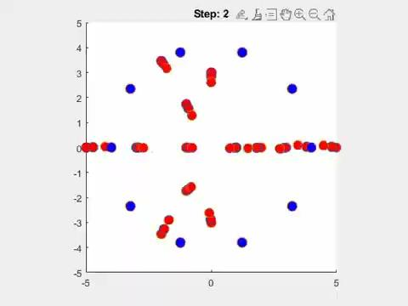
Simulation 0_0

Slide 9
Next Steps / More Problems
HEEELLLP :)
Largest distance between sleeves/pins?
Interesting hexagonal array?
Ideas above platform?
Sleeves are flexible (for voice coil integration), but not very compatible with translation

